Slide 1
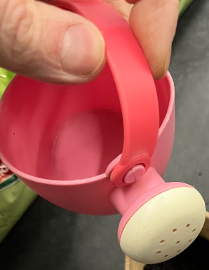
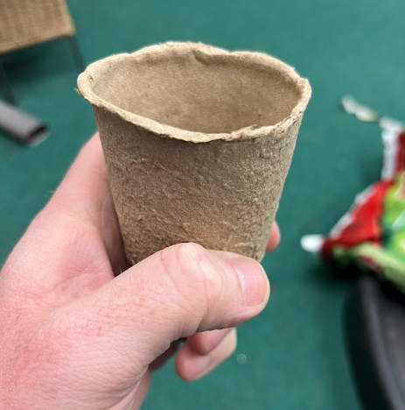
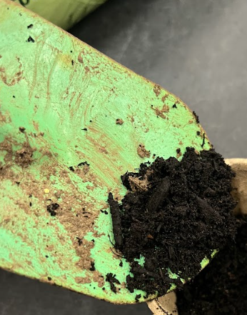
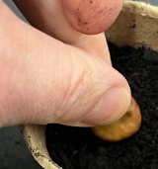
1 first
2 next
3 then
4 after that
**out of correct order - sequence on the screen

Slide 2
1 first
pot
2 next
soil
3 then
seed
4 after that
water
*use as a prompt to help with writing

