Slide 1
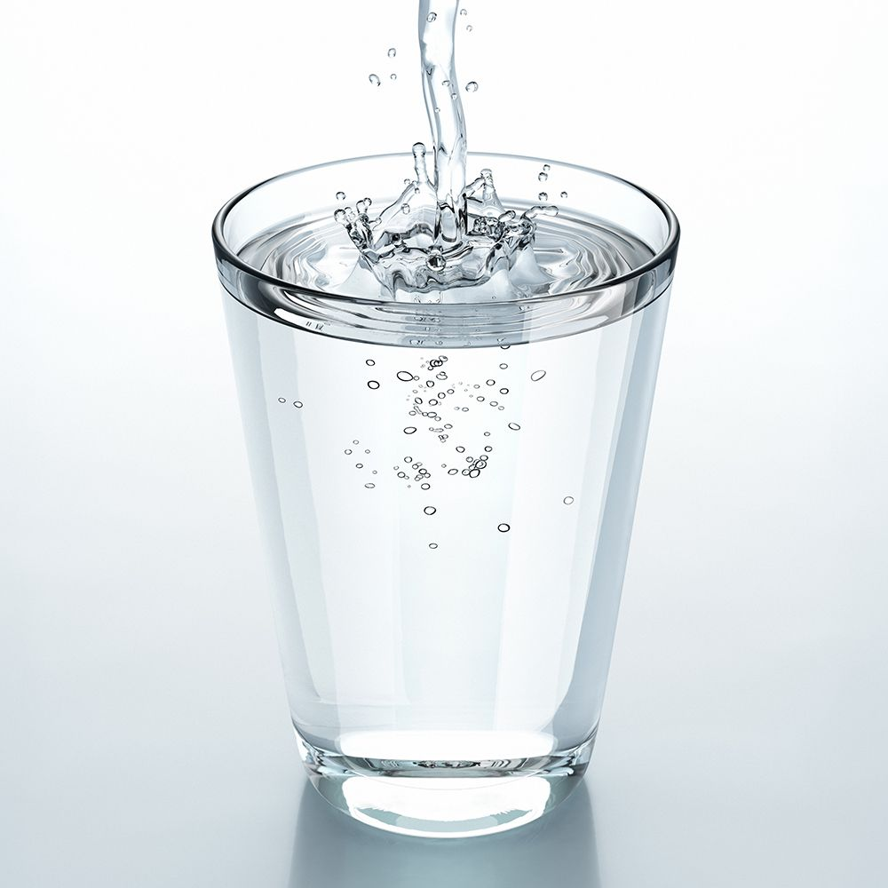
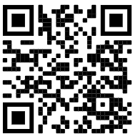
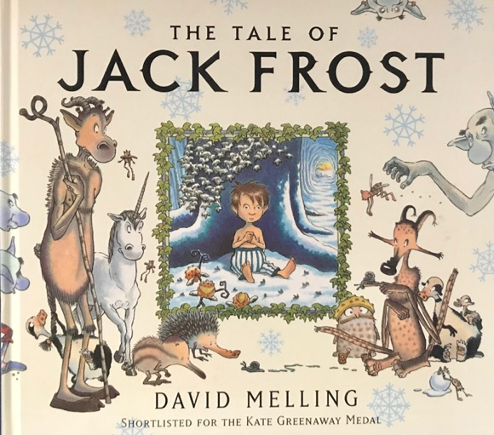
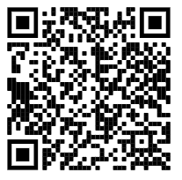
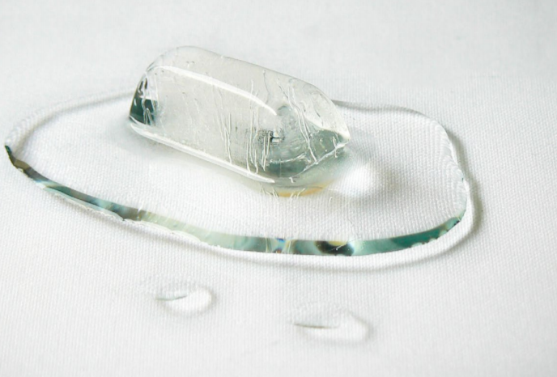
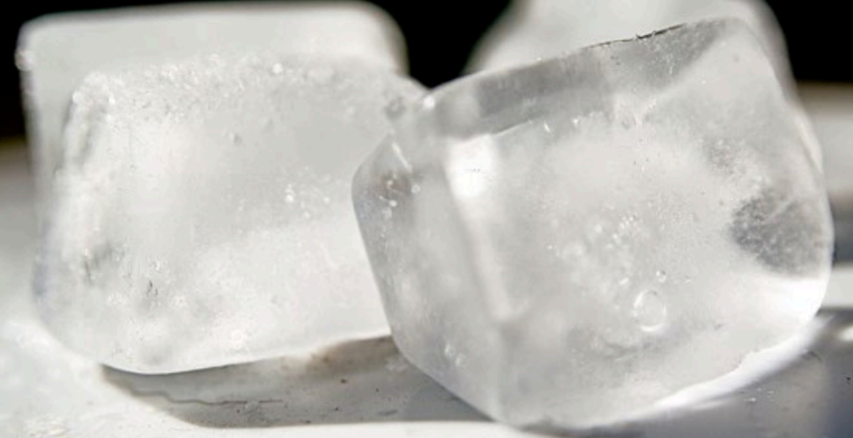
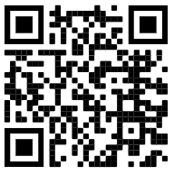
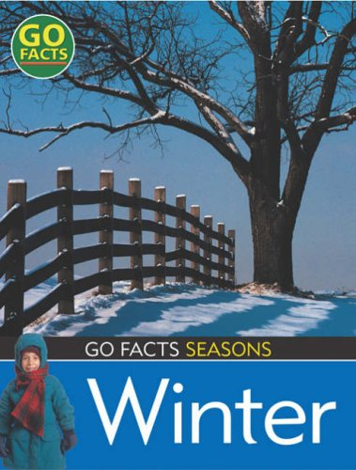
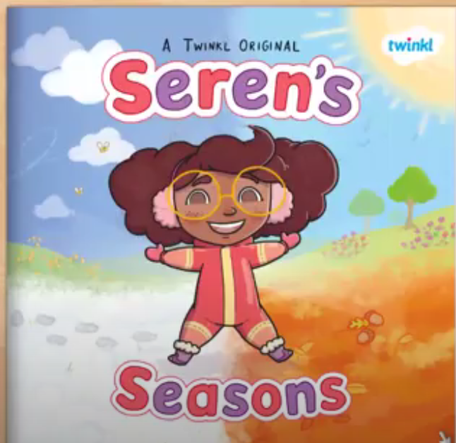
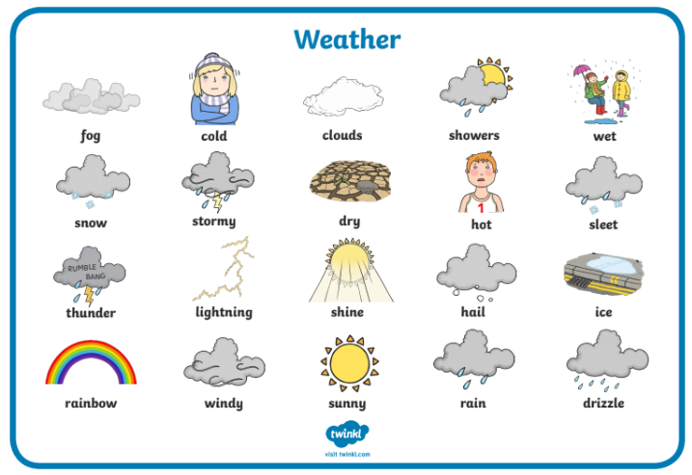
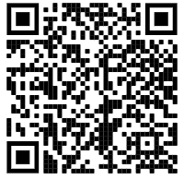
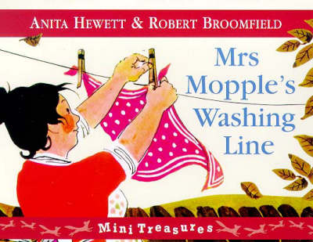
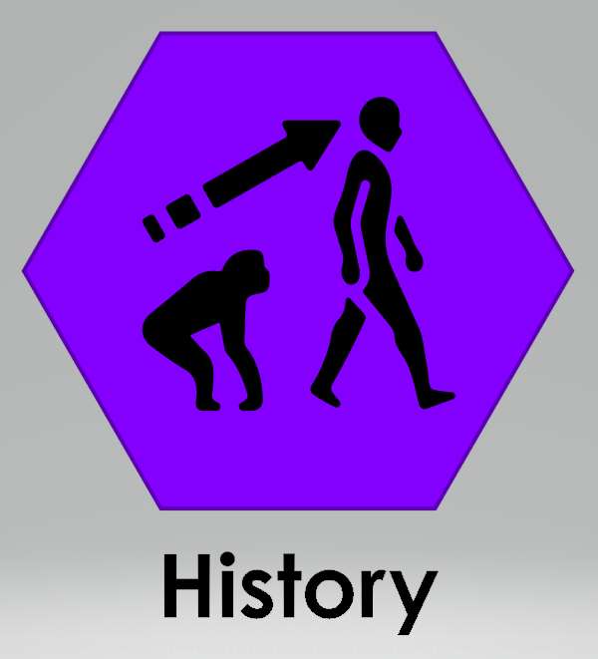
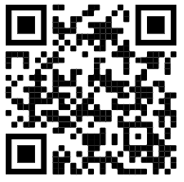
F2: Spring 1: The World Around Us (Hawthorn / Rowan)
New Years: What can I get better at? | 2) How do I know its winter? (Signs) | 3) What do I need to wear in winter? | 4) What do animals do in winter? | 5) Can I describe the weather?
Key Books
Ice! The ice in ‘Jack Frost’ begins to melt. Let’s explore this!
Winter - Winter is the coldest time of the year. It is one of the four seasons. Winter comes after autumn and before spring.
Liquid water can freeze when it is really cold, turning it into solid ice.
Simple Facts about Winter (Word Collector)
Winter is the coldest season.
Snow falls in the Winter.
Trees stop growing in the Winter.
Plants stop growing in the Winter.
Nights are longer in the Winter.
Some animals hibernate in the Winter.
The Tale of Jack Frost (Author David Melling)
Experiences:
We’re going on a winter walk - let’s look for signs of winter.
Catching our reflections using mirrors to then create self portraits.
Sorting clothes suitable for winter.
The warmer the ice gets, the quicker it melts and turns back into liquid water.
Can you make ice at home? Put a cup of water in a cupboard and one in the freezer, which will turn into ice? why?
melt
melting
Questions to ask at home: How do you know it is winter? Can you point out the signs of winter?
freeze
ice
When the ice warms up it begins to melt.
Winter and Weather key vocabulary
Scan to go on a Winter Walk!
Rain | Wet, damp, droplet, soggy, shower.
Wind | Rustle, flutter, flap, whistling, howling, gale, breeze/
Snow | Cold, freeze, frozen, icy, snow flake, soft, hard.
Fog | Dark, dull, mist.
Non Fiction: Go Facts: Seasons: Winter
Experiences:
Plants / garden in the winter.
People in the winter - clothing and comparing the UK to the Arctic.
Animals in the winter - bird watching and making bird feeders.
Siren’s Seasons (Author:Twinkl) / Weather
Experiences:
Exploring different types of weather.
Keeping a weekly weather log.
Cloud spotting and making clouds.
Waterproof clothing
Making rain shakers.
Where in the world… Cloud Forests of Africa.
Use a camera, phone or ipad to take photos of what you find.
Mrs Mopple’s Washing Line (Authors: Anita Hewett / Robert Broomfield)
Experiences:
Exploring the wind (effects and uses)
Story retelling / drawing a story map
Investigating how people washed their clothes before wash machines / electricity.
Exploring the sounds of the wind and making musical instruments to recreate wind sounds.
Rainbow experiment
We can create a rainbow by placing coloured skittles around the edge of a white dish. Try adding drop of cold water / warm water.
What can you see? Which water worked best?
Rhythm
Explore rhythm, create rhythms and suggest symbols.
Rhythm - a strong, regular repeated pattern of movement or sound.
Spring | Summer | Autumn | Winter

Slide 2
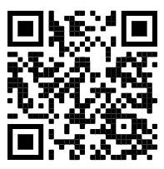
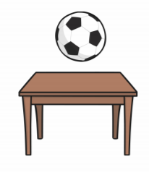
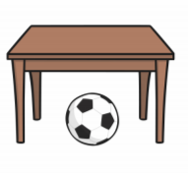
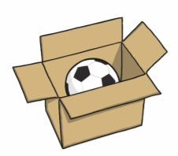
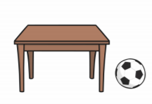
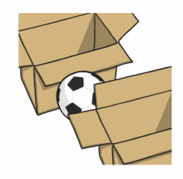
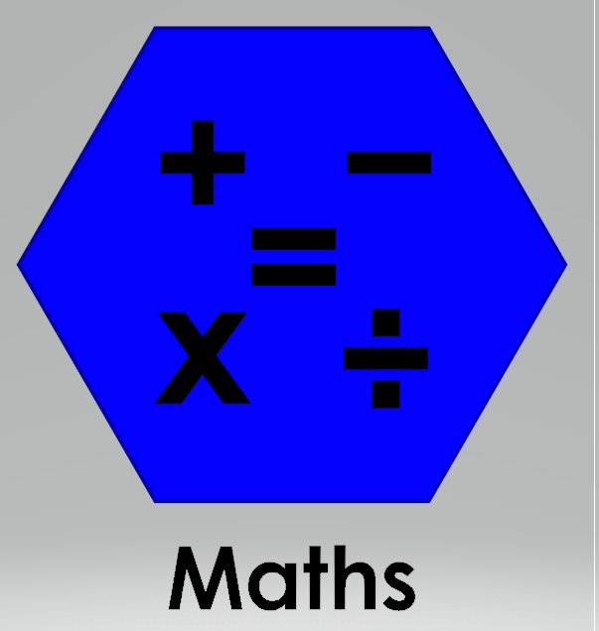
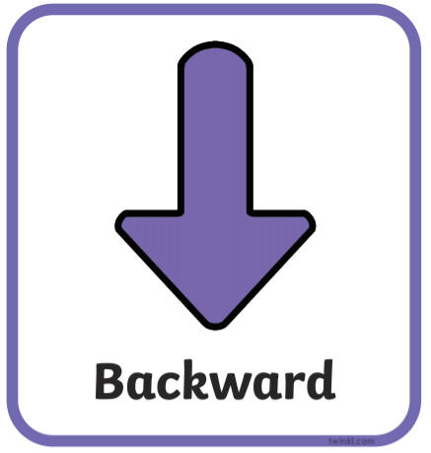
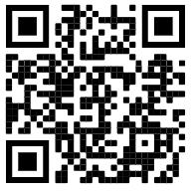
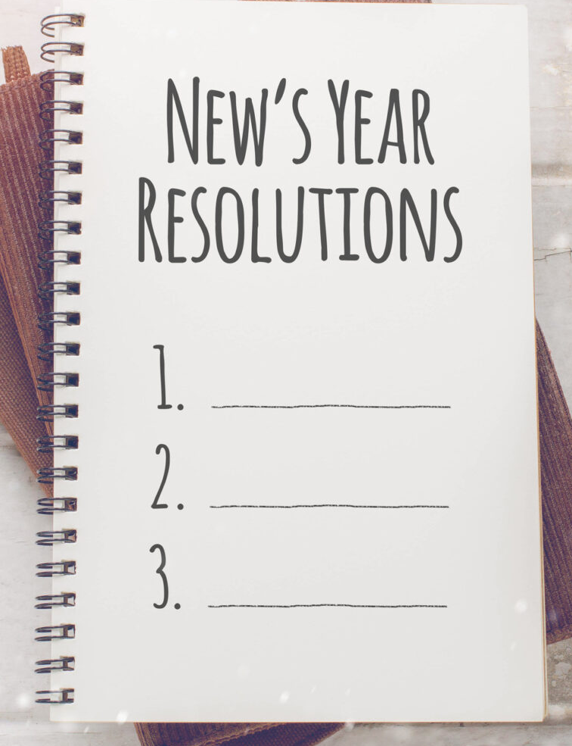
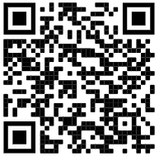
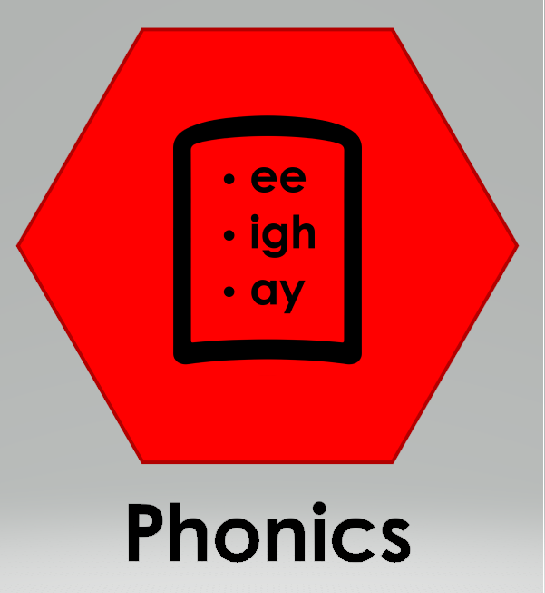
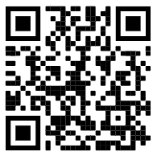
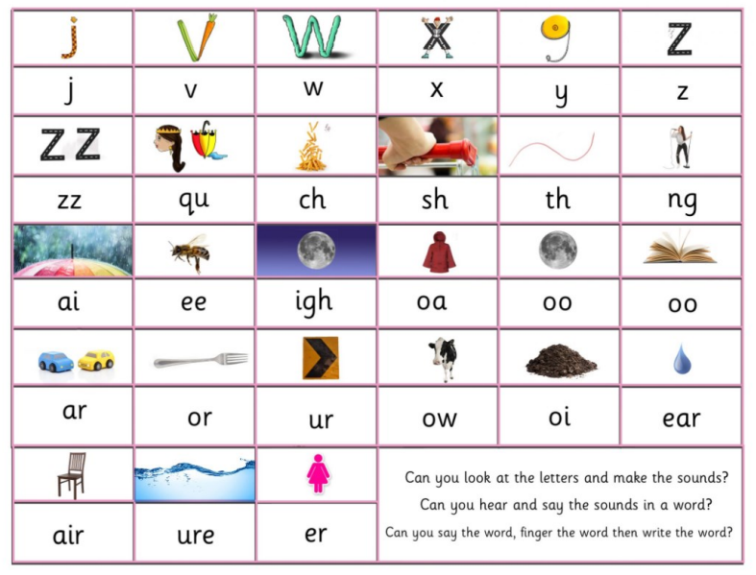
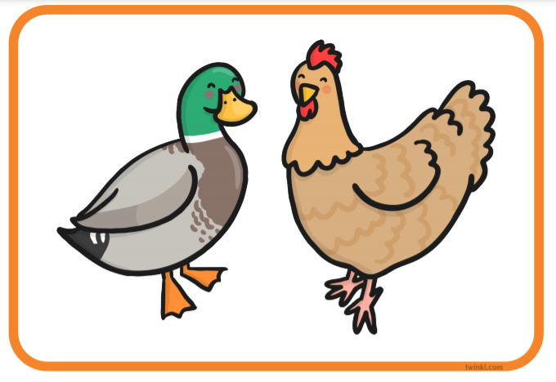
Physical Development: Ball Skills
Our main learning intentions for PE this half term:
I can throw, kick, pass and catch a large ball
I can use small equipment showing co-ordination. E.g. quoits, beanbags.
Key Vocabulary: throwing, catching, kicking, passing, batting, and aim.
Mathematics: Positional and directional language
Positional language: describes where something or someone is.
Directional language: describes a route, like giving someone directions on a map.
Expressive Arts and Design:
Attaching /modelling- Glue stick, PVA glue, spreaders, sellotape, masking tape.
Joining different media & creating new effects.
Key words: cut, attach, spread.
Tools: scissors, glue spreaders.
Experiences may include:
Creating clouds using self chosen materials (wet, dry, flaky, smooth, soft, fluffy, sticky).
Creating using a range of 3D shape recycling materials and block play (flat)
Exploring ideas: creating cloud dough / playdough following instructions.
Drawing: Paying close attention to facial features and detail when drawing.
Tools: pencils, colouring pencils, crayons, felt pens.
Experiences may include:
using mirrors to catch our reflection, describe what we can see and draw self portraits.
Observational drawings of the weather.
above
under
underneath
in
inside
on top
beside
next to
between
behind
Understanding the World: People and communities
Can you draw a treasure map and use the directions to find the treasure?
Scan to learn how to make cloud dough.
Jigsaw- Dreams and Goals
We will be sending home your child’s login details for Reading Planet.
We will share our ideas about things we would like to achieve this year.
Scan this code to find out more information about Chinese New Year.
Digraph: two letters that make one sound.
Trigraph: three letters that make one sound.
Literacy: Reading
Continue to learn Phase 3 sounds
Using our phonics to help us read:
Blend and segment known sounds for reading
Read simple phrases and sentences made up of words with known letter–sound correspondences and, where necessary, a few exception words.
VC words: at, it.
CVC words: mum, dog, pin, sat.
CVCC words: milk, hump, sand.
Literacy: Writing
Orally compose a caption and hold it in memory before attempting to write it with support.
Oral Segmenting - this is when you split a word up into its individual sounds (c-a-t). We call this ‘robot talk’.
Scan to hear Phase 3 sounds.
Orally compose (say) a caption.
Tap, clap, stomp the caption.
Count how many words.
Say first word / robot the word / write the word.
See the word, say the word! (sight words).
Oral blending - this is when you blend the sounds together to say the word (cat). We use a blending arm motion from left to right to help blend the sounds together.
A duck and a hen.
“Look at the letter, make the sounds and blend the sounds together”
Write from left to right and top to bottom. Begin to form recognisable letters.
Where do you put your finger when you read?
Can you practise writing each letter of the alphabet using the handwriting rhymes we have sent home? Check St Mary’s Fields YouTube for handwriting videos.
Can you draw a picture and write a simple caption?

