Slide 1
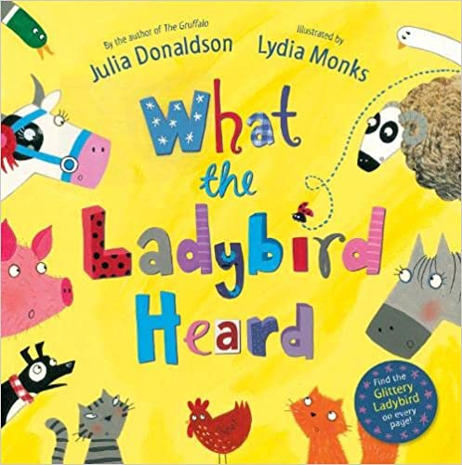
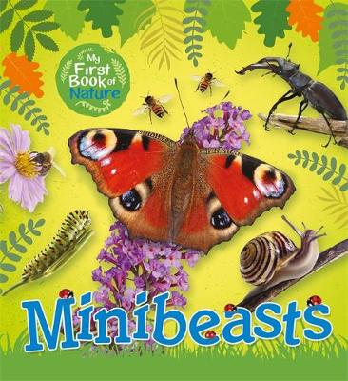
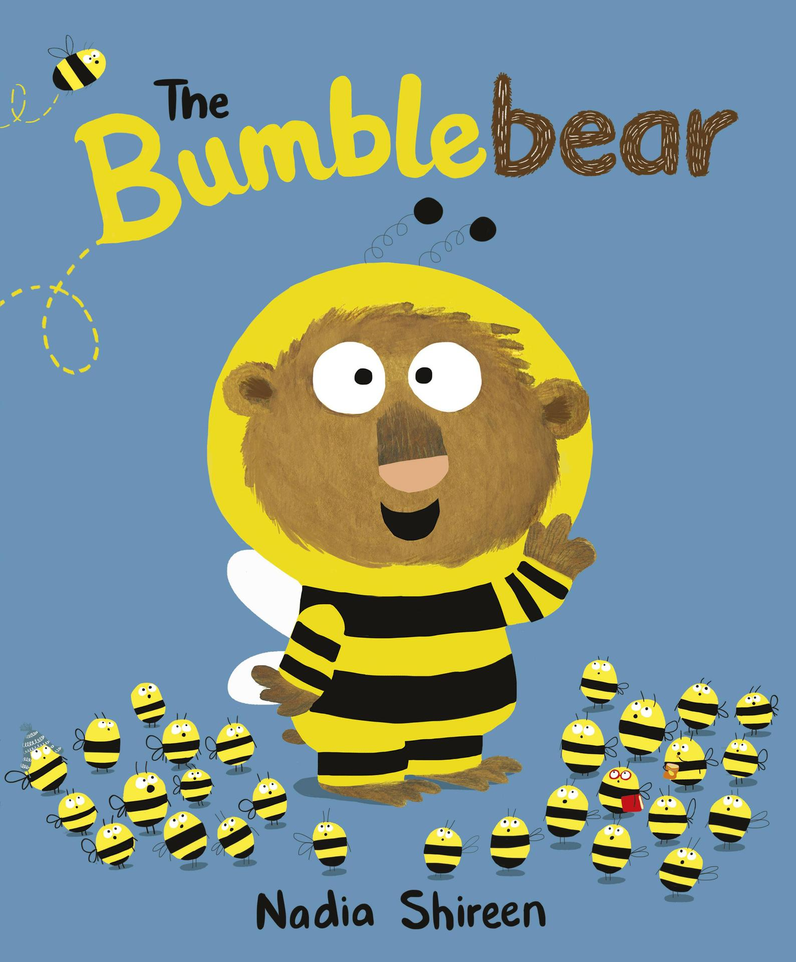
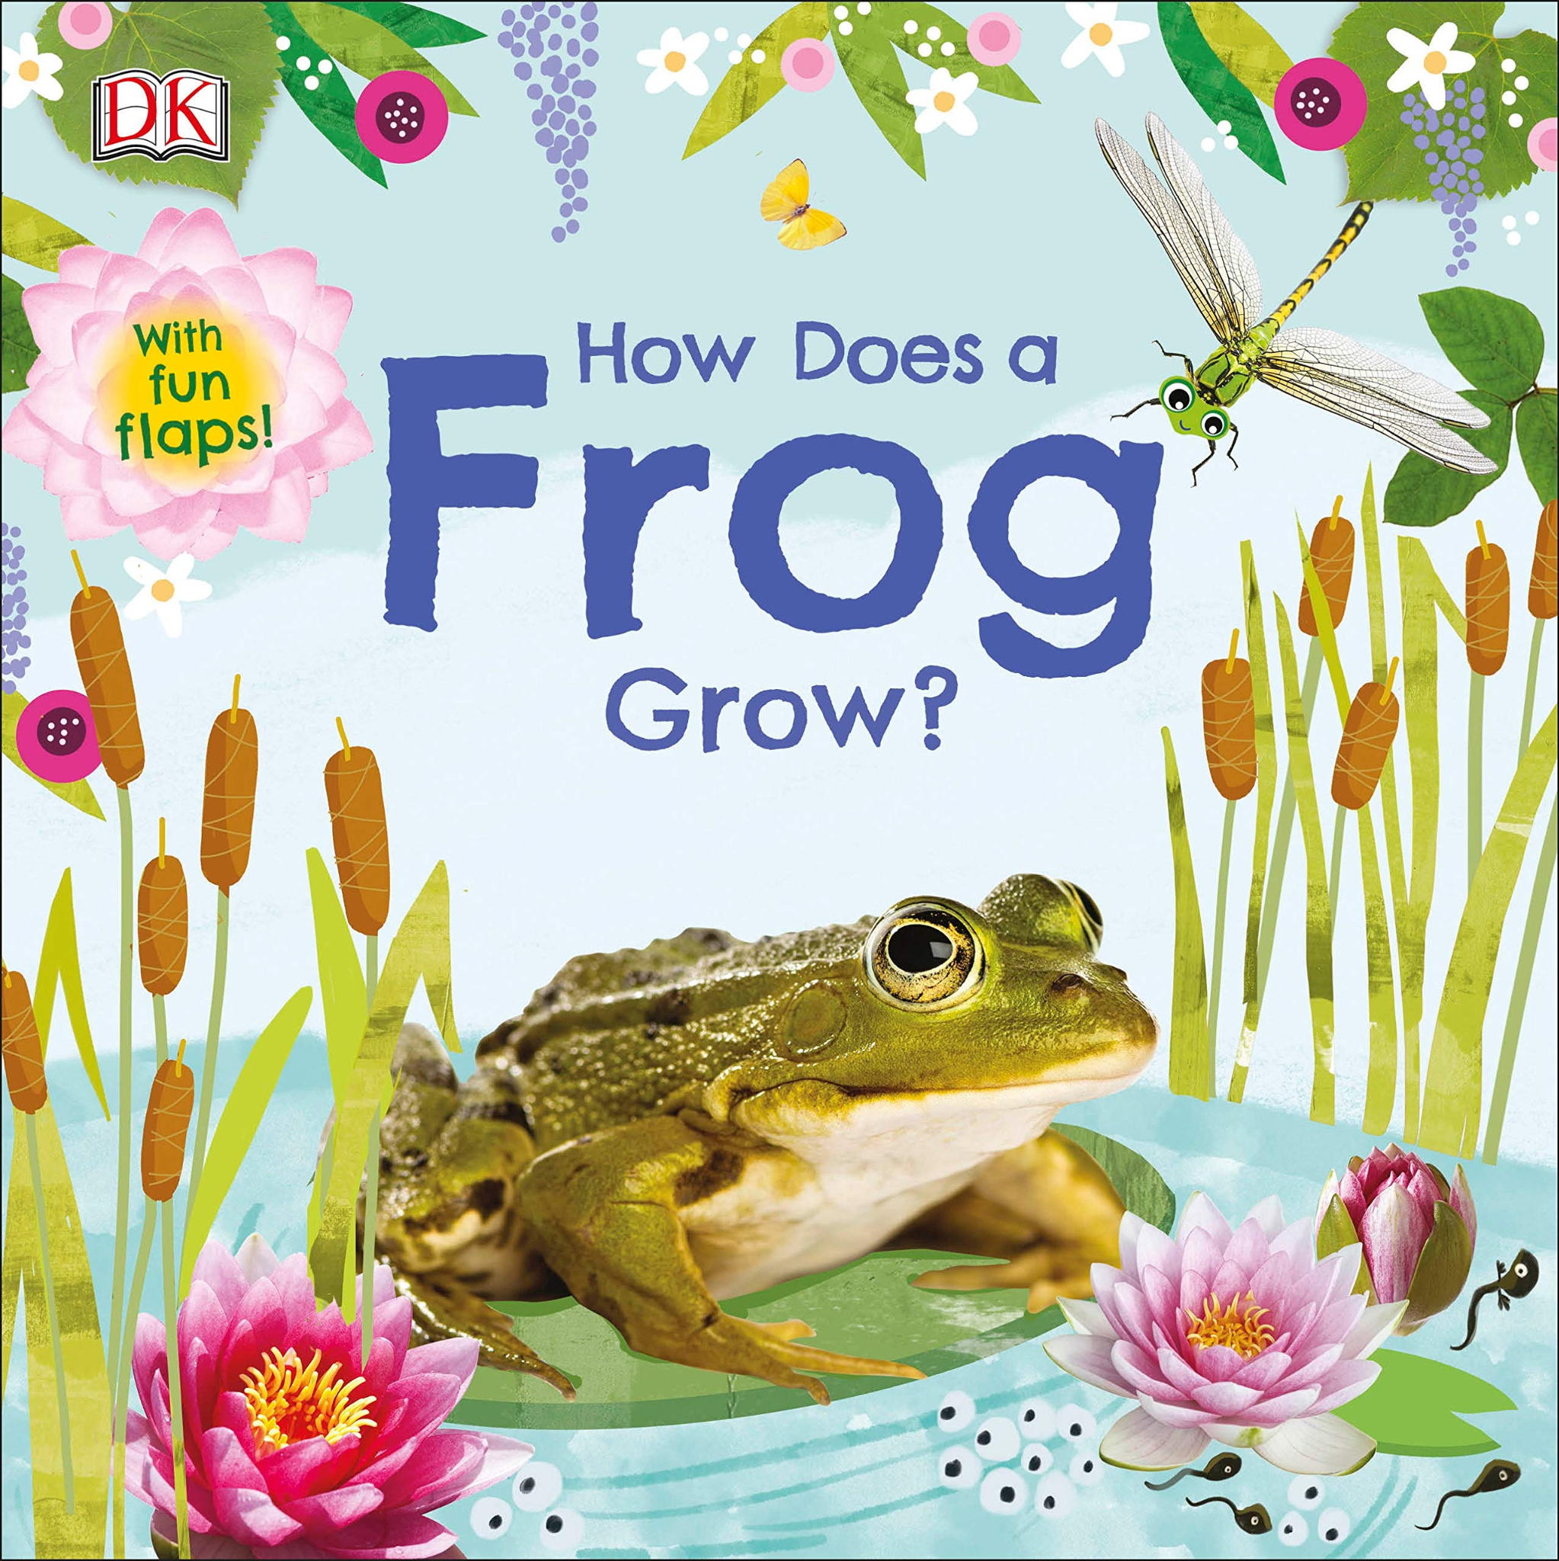
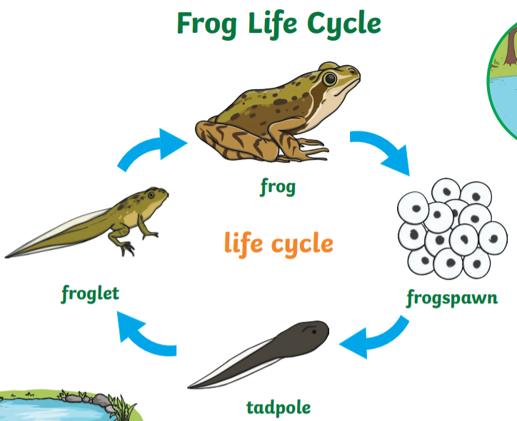
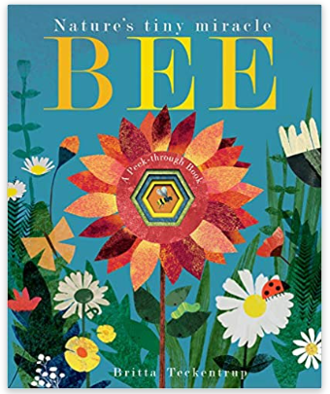
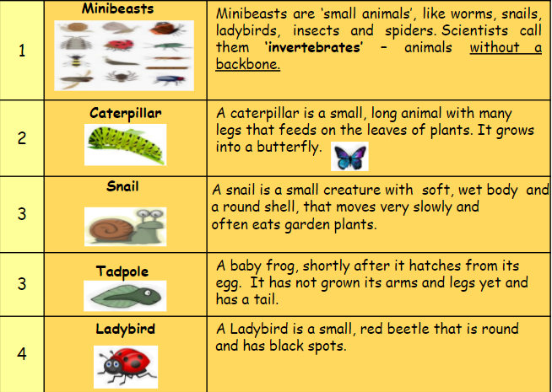
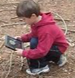
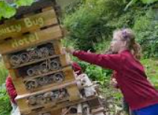
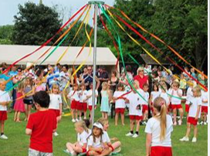
FS2: Knowledge Organiser: Summer 2: The Great Outdoors
We will be
using our
enthusiasm,
listening and
communicating
character muscles.
Key Books this term:
Possible lines of enquiry: Summer, Mini beasts (insects),
Ourselves (growing and moving on).
Farm Animals
Possible learning experiences:
Farm to Fork - looking at the food and other produce we get from the farm.
Naming and describing different farm animals and the food / products they give us.
Of course we will be trying to retell the amazing story!
Mini Beasts
Possible learning experiences:
Minibeast outdoor exploration and studying
Drawing minbeasts
Building a bug hotel
Observing frog spawn - Frog lifecycle
Spinderella by Julia Donaldson - Read with Joy! Julia Donaldson stories - YouTube
Five Little Caterpillars | Five Little Series | Kids Tv Nursery Rhymes – YouTube
Can you make your own bug hotel at home?
Bug Hotel Plans DIY | Build an Insect Hotel - The RSPB
Developing our reading skills!
We will use the ipads to take photos of what we observe around us.
We will learn how to use Picollage to record our exploration.
Correctly sequence a story or event using pictures and/or captions.
Respond to questions about how and why something is happening.
Know the difference between different types of texts (fiction, nonfiction, poetry)
spring | summer | autumn | winter

Slide 2
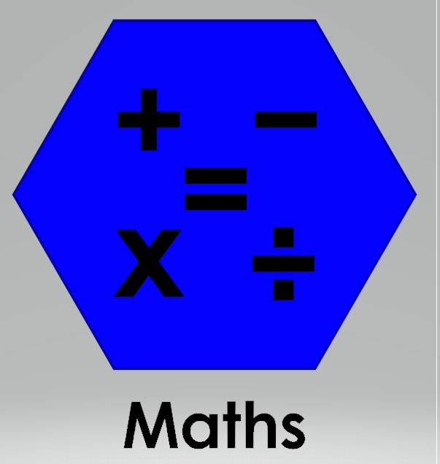
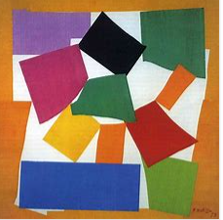
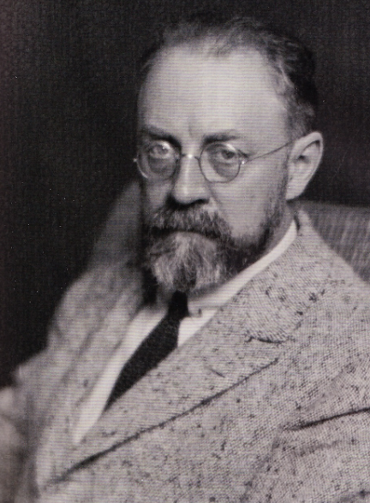
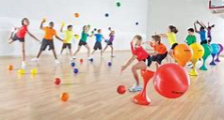
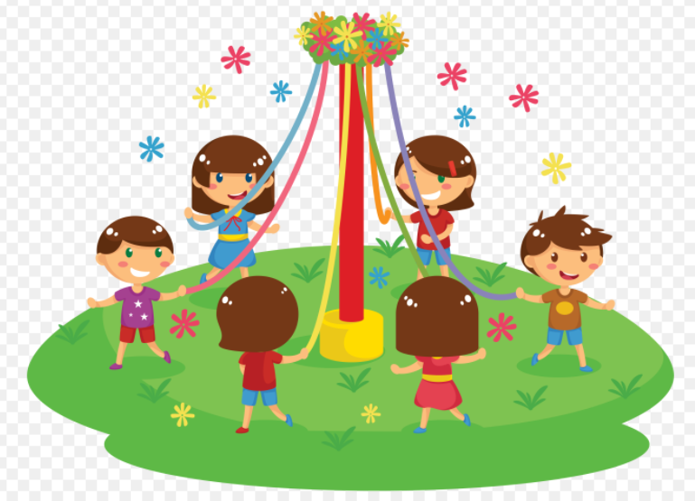
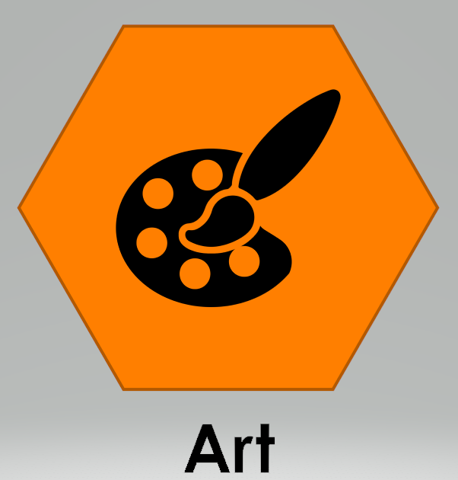
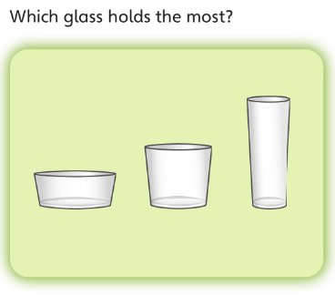
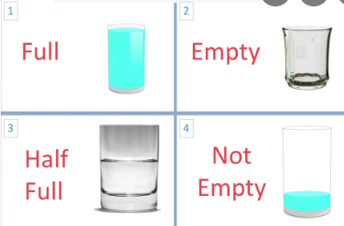
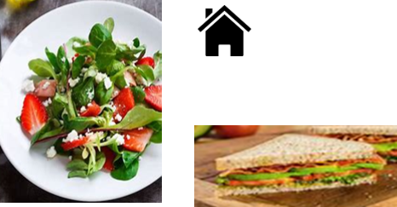
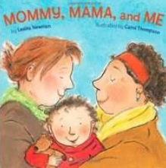
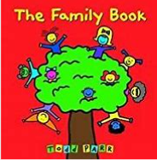
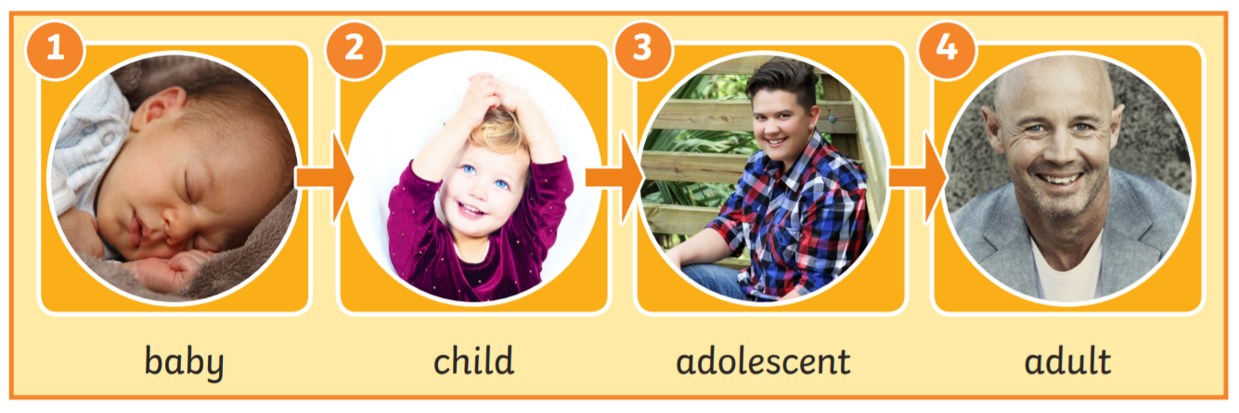
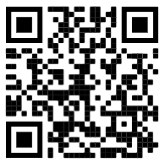
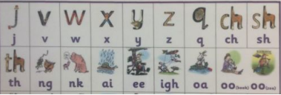
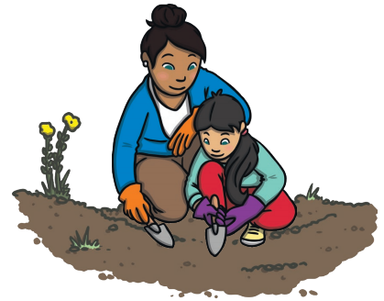
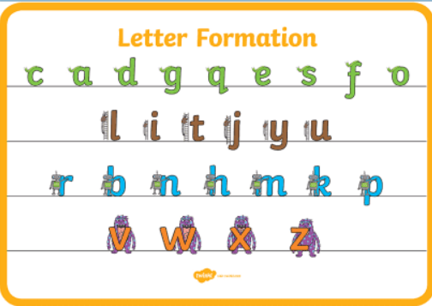
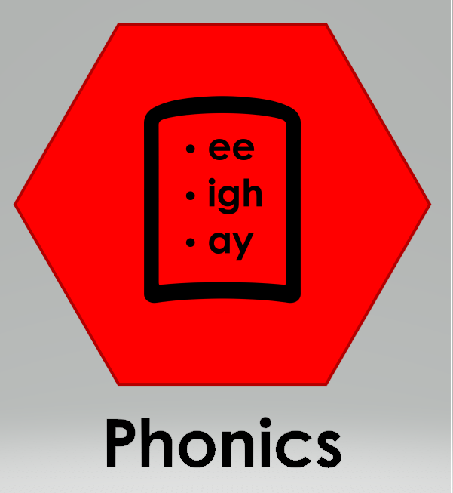
Physical Development: Gross and Fine motor Skill
Handwriting - Develop the foundations of a handwriting style which is fast, accurate and efficient.
Physical Development - I can travel around space and obstacles safely. Combine different movements with ease and fluency.
I can move in different ways- run, jump, skip, climb.
r
jump land underarm control roll Maypole dancing
Mathematics: Number
We will continue to learn about number counting patterns. Knowing that teen numbers are made up of 10 and another number
We will be building on our knowledge of halving, doubling and sharing using these number up to 10 as a minimum.
Measures: Volume/Capacity: We will use language to describe volume and capacity.
Capacity: this is the amount of liquid that can be contained in a container.
Expressive Arts and Design:
Artist: Henri Matisse: The Snail collage
We will be making repeated patterns using 2D shapes in the style of Henri Matisee.
Can you make a repeated pattern with
things you find outside?
Using tools to create a healthy salad.
We will be learning how to safely use tools to make our salad - cut chop slice
Religious Education
Stories from different religions: Christianity, Islam, Hinduism, Sikhism.
What can we learn from stories? How do they make us feel?
Vocabulary: feel, happy, sad
At the dinner table, compare each other’s drinking containers, how much is in each?
Can you practise using a knife safely at home to cut and peel vegetables and fruit?
Everyone’s Welcome: The Family Book / Mommy Mama and Me
Jigsaw: Changing me
Changing bodies / caring friendships.
How do we feel when changes happen?
We will look at the different stages of human growth.
Literacy: Reading
Literacy: Writing
Orally compose and write a few simple sentences with a full stop.
We can dig in the soil.
We can see lots of bugs.
Some of us may begin to write simple
sentences using the story language First,
Then, After that, Next
Consolidate Phase 3
Spell words by drawing on knowledge of known grapheme correspondences.
Make phonetically plausible attempts when writing more complex unknown words.
Oral Segmenting - this is when you split a word up into its individual sounds (c-a-t). We call this ‘robot talk’.
Scan to hear Phase 3 sounds.
Orally compose (say) a phrase /sentence.
Tap, clap, stomp.
Count how many words.
Say first word / robot the word / write the word.
Form most lower-case letters correctly, starting and finishing in the right place, going the right way round and correctly orientated. Include spaces between words.
Oral blending - this is when you blend the sounds together to say the word (cat). We use a blending arm motion from left to right to help blend the sounds together.
Using our phonics to help us read:
Continue to apply knowledge of blending and segmenting to reading and spelling simple two-syllable words, captions and simple sentences.
Digraph: two letters that make one sound.
Trigraph: three letters that make one sound.
Can you write some instructions on how to make a salad?
Can you draw a picture of a minibeast and label it?
Can you practise writing the letter families?

